Slide 1
Introduction

Slide 2
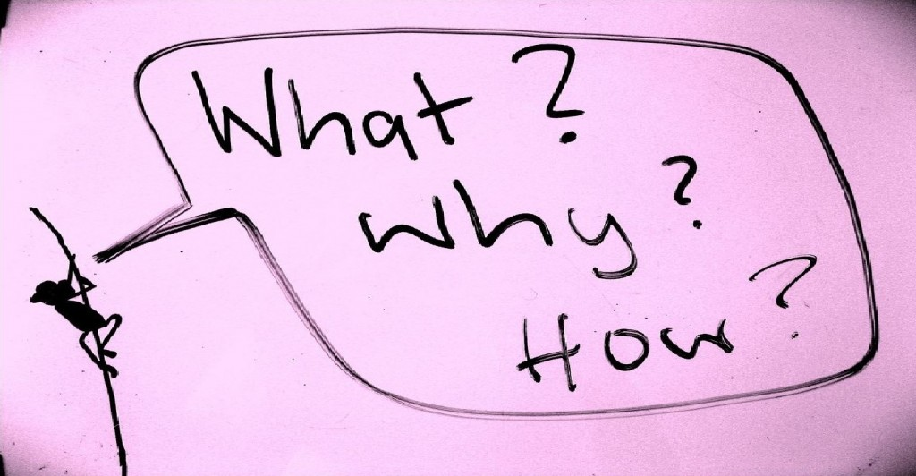
Introduction
Notes:
In this PowerPoint we will discuss the first part of the report that you’ll be completing, the introduction.
In the introduction you answer questions such as:
What is the report about?
What is the central question?
Why is it important (problem area + relevance)?
How will you answer the question (structure of the report)?

Slide 3
INTRODUCTION Assessment criteria Rubric
Funnel model (from general to specific)
The following components are properly described in the introduction:
Introduction of the subject
A brief outline of the problem area
Theoretical framework and/or current problem area
Relevant theoretical concepts
Description of prior research
Central question (clear, unambiguous, follows logically from introduction), incl. substantiation innovative element / added value of the literature review
Description of article’s structure
Notes:
The central question must logically follow from the introduction of the subject. For this you'll need to indicate the question's relevance. Why is it interesting? Because it happens a lot; because it's a serious issue; because it's relatively unknown...Start out big, narrowing the subject down as you get closer to your question (funnel model). Make sure that the introduction actually contains the central question. Not between the lines, but explicitly. Finish with a short description of the structure of the report so the reader will know what to expect from the rest of the text.

Slide 4
Introduction of the subject
Goal → Present the topic & generate the interest of the reader
For example, with:
Formulation of a remarkable statement
Description of an interesting phenomenon
‘Adolescents take more risks than children or adults do, as indicated by statistics on automobile crashes, binge drinking, contraceptive use, and crime. Trying to understand why risk taking is more common during adolescence than during other periods of development has challenged psychologists for decades’
‘Attention-deficit hyperactivity disorder (ADHD) is the most common psychiatric disorder among children and adolescents.’

Slide 5
Outline of the problem area
Theoretical framework
Embedding your own literature study in existing research
What is known (description of previous research)?
What is not yet known/what is still unclear (gaps)?
Definition of key concepts and how they relate to one another?
Current problem area
What is the scope of the problem?
Why is this problem relevant?
Support your claims with numbers and studies (Cite your sources!)

Slide 6
Central question
Clear, unambiguous, follows logically from introduction
Clearly identifiable in the text and demarcated (but does not necessarily have to be formulated as a question)
e.g. ‘The aim of this literature review is to examine the effectiveness of neurofeedback for the treatment of ADHD in children and adolescents.’
Clear scope (focus): What is included/what is not included and why?
Relevance of the question should be clear
Innovative element/added value of the literature study
What does it contribute?

Slide 7
Description of article’s struture
Goal → Clarify what the reader can expect
What information will be covered?
How is the information organized (i.e. sequence)

Slide 8
Pitfalls introduction
Introduction to the topic:
- Insufficiently related to demand
- No proper link/bridge is made to demand
Outline problem area:
- Unclear what the problem is
- Theoretical framework is missing
- Definitions of key concepts are missing
Innovative element/added value of the literature review
- Relevance not clear or insufficiently substantiated
- Description of the structure of the article is missing

Slide 9
Example 1: Factors influencing the accuracy of judgements of learning
Nowadays, with all the electronic and social media surrounding us, it's becoming far more difficult for students to maintain the focus during self-directed learning activities. In 2010, 73% of American teenagers used social media websites (Lenhart, Purell, Smith, & Zickuhr, 2010). This distraction has made it harder to study effectively. Azevedo (2010) describes a number of factors influencing the effectiveness of self-directed learning, i.e. knowledge of self-regulating skills, motivation and judgements of learning. This report mainly focusses on one of these factors, namely: judgements of learning.
Notes:
Have a look at this introduction. What do you think of it? Does the question logically follow from the introduction?

Slide 10
Introduction not related to the question
Nowadays, with all the electronic and social media surrounding us, it's becoming far more difficult for students to maintain the focus during self-directed learning activities. In 2010, 73% of American teenagers used social media websites (Lenhart, Purell, Smith, & Zickuhr, 2010). This distraction has made it harder to study effectively. Azevedo (2010) describes a number of factors influencing the effectiveness of self-directed learning, i.e. knowledge of self-regulating skills, motivation and judgements of learning. This report mainly focusses on one of these factors, namely: judgements of learning.
Notes:
The introduction to the subject doesn't quite match the question. At first glance it appears to create the impression that the text is about to discuss ways to deal with distractions during studying. Only later does it turn out that the piece is on judgements of learning. The author would have done better if he'd discussed what issues students have in accurately assessing their learning activities.

Slide 11
Example 2: Factors that affect the attractiveness of average faces
What makes one face more attractive than the next? Many researchers have tried to answer this question. The averageness hypothesis has become a trend in recent years. Average faces are regarded as more attractive. This literature report discusses what the reasons for this could be and how this has been studied in the past. The question whether averageness plays a role in the attractiveness faces has already been answered positively (Jones & Hill, 1993; Langlois & Roggman, 1990), but what are the specific factors that play a role in rating the attractiveness of average faces?
Notes:
Have a look at this example. What is the problem area here? Why is it relevant to answer the question?

Slide 12
No problem area or relevance included!
What makes one face more attractive than the next? Many researchers have tried to answer this question. The averageness hypothesis has become a trend in recent years. Average faces are regarded as more attractive. This literature report discusses what the reasons for this could be and how this has been studied in the past. The question whether averageness plays a role in the attractiveness of a face has already been answered positively (Jones & Hill, 1993; Langlois & Roggman, 1990), but what are the specific factors that play a role in rating the attractiveness of average faces?
Notes:
The example fails to highlight the problem area, causing the question's relevance to remain untouched (also note the unscientific language used in the text).
The author should have indicated in the introduction that, for example, a lot has yet to be explained on the factors that affect the attractiveness of average faces. In doing so he could have also briefly discussed some of the contradictory findings contained in the literature.

Slide 13
Example 3: Decision making process and adolescent risk behavior
Adolescence is a life stage in which individuals are more likely to participate in health risk behaviors than at other life stages. This has potentially dangerous and life altering consequences. For example, in the United States, the majority of all deaths among adolescents and young adults aged 10–24 result from unnatural causes (CDC 2010). […] A potentially critical factor contributing to adolescent risk behavior is the decision making process that adolescents engage in when opportunities for risky behavior arise (Steinberg 2004).
Topic becomes clear in first sentence
Outline problem area
Information from broad to specific
Notes:
This example was included to show what is meant by a strong introduction to the subject.
We have chosen to select a real article to show that you can also use articles as examples on how to write your report.
Several issues are important in this example:
The opening sentence highlights the report's relevance (adolescence and health risk behaviors).
The authors kick off by mentioning facts indicating the subject's relevance (risk behaviors have dangerous and life altering consequences)
The statements are supported by sources.
The subject focusses on one of the factors affecting risk behavior (decision making process). You can clearly see that the author is narrowing down the subject here as he works towards the central question. What also stands out is how it logically moves from broad to narrow (it shows a clear relation between the broad introduction and how it is narrowed down towards a specific question).
NB: The outline of the problem area in this example has been shortened (theoretical framework, theoretical concepts and previous research are covered in more detail in the original article)

Slide 14
Example 3: Decision making process and adolescent risk behavior
Understanding the linkage between decision making and risk-taking could illuminate the processes leading to adolescent risk behavior and would have implications for programs and social policies designed to reduce risky behavior and improve adolescent health. Despite the logical connection between decision making processes and risk behavior, relatively little research has addressed this link. Thus, we know surprisingly little about the relationship between decision making proclivities and adolescents’ participation in typical risk behaviors (e.g., engaging in drug use or unprotected sex). The main aim of the present study was to examine this link.
Added value /Innovative element
Central question
Notes:
The following aspects stand out in this second part of the introduction:
The author clearly indicates why it is relevant to highlight the link between decision making and risk-taking. This explains the questions relevance (implications for programs and policies / little empirical evidence for the link between decision making and risk behaviors / little known about this relationship). This explains the added value of the research.
The central question is explicitly highlighted ("the main aim is to examine this link").
NB: In this example we see the author begin by highlighting the question's relevance and only then proceed to outline the problem area. You may elect to outline the problem area first, followed by the question, followed by its relevance. The point of the matter is that the introduction is structured logically and that there are no sudden jumps the reader is unable to understand.
NB: In this example, the author first indicates why the question is relevant. You can of course also choose to first map out the problem, then introduce the question and discuss the relevance of the question. What matters is that the introduction is structured in a logical way and does not contain sudden transitions that seem to fall out of the blue to the reader.

Slide 15
Example 4: Social comparison and envy on social media
Social media (SM) such as Facebook, Instagram, and TikTok continue to attract billions worldwide while concerns about their impact on users’ well-being are unabated [1]. Recent overviews [2e4] of meta-analyses on this issue find overall small negative associations between social media use (SMU) and some, but not all, well-being indicators among adolescents [4] and young adults [2,3]. Yet associations are heterogeneous and likely depend on numerous boundary conditions and mechanisms [3,4]. Several reviews [5e7], plus Facebook’s own research [8,9], point to social comparison and envy as key mechanisms.
Introduction of the subject
Description prior research
Notes:
Here's another example of an introduction from an original article.

Slide 16
Example 4: Social comparison and envy on social media
Social comparison is the process of thinking about information about one or more other people in relation to the self [10]. Comparisons represent a fundamental human cognition [11] occurring across cultures [12], helping humans navigate social groups by providing them with information about their own relative standing [13]. Despite these benefits, upward comparisons with those who do better than oneself have been identified as potentially problematic [14], especially on SM [7]. As
users present a positively-biased version of themselves online [15], upward comparisons are assumed to be more frequent and harmful on SM [7]. They may particularly elicit envy, the pain caused by the good fortune of others, which can impair well-being [16,17].
Definition theoretical concepts
Current problem area

Slide 17
Example 4: Social comparison and envy on social media
Whereas this negative view dominated research on SM
upward comparison and envy in the 2010s, recent studies also point to positive outcomes such as inspiration [18e20]. More generally, authors [18,20e23] including original proponents [6,24] have begun to question whether the effects of passive SMU (i.e., just browsing SM without interacting) are as detrimental as previously assumed and whether “active” versus “passive” use is a useful dichotomy to explain well-being effects.
Gaps in prior research

Slide 18
Example 4: Social comparison and envy on social media
Our review seeks to advance this debate, first, with a synthesis of prior reviews and recent key studies. The goal is to provide both a comprehensive update and critical appraisal of the most relevant evidence. Note that we exclude studies solely investigating appearance comparison or body image because an up-to-date review of this literature appears in this special issue [25]. Instead, our review includes studies measuring all non-specific social comparisons and envy, which may be elicited by various self-presentations of people’s work, leisure, travel, health, or appearance, among others. Second, and building on this evidence synthesis, we identify and critically discuss four major limitations of the literature, which point to crucial questions for future research.
Added value
+
Description article’s strcuture

Slide 19
INTRODUCTION Tip
Be inspired by the articles you've read for this report:
- How do the authors open their article?
- How do they structure their introduction?

